Slide 1
Computer Fundamentals
“Software”

Slide 2
Agenda
What is Algorithm
Software
Machine Language
Assembly Language
High Level Languages
Libraries/Packages/Frameworks
Backend/Frontend

Slide 3

Notes:
Kahoot url: CF Review https://create.kahoot.it/details/a631b609-2c84-4d21-a9fe-cbe5f8ca47f1

Slide 4
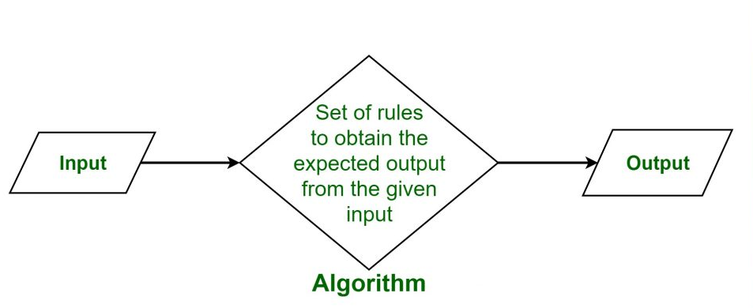
What is Algorithm

Slide 5
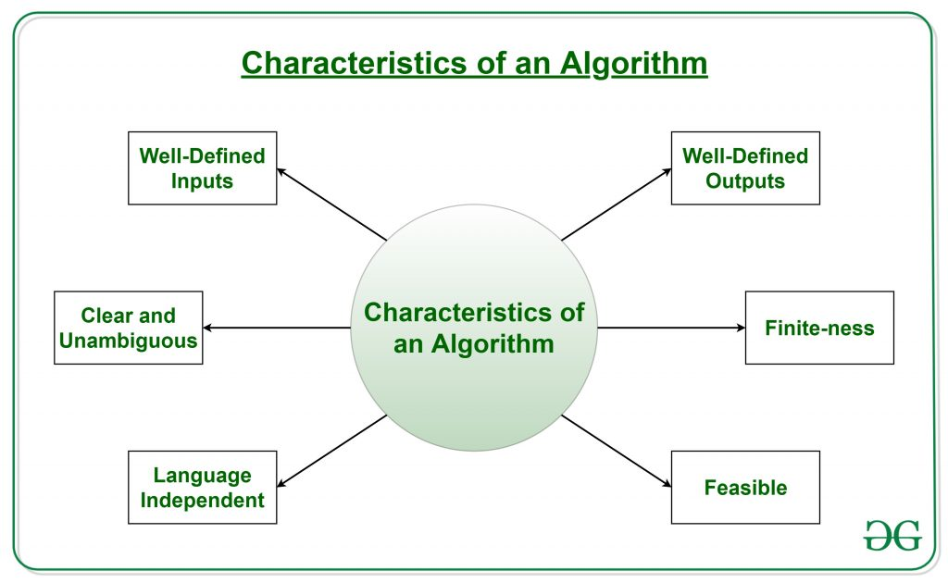
What is Algorithm

Slide 6
What is Algorithm
Tea Brewing Algorithm:
Put the teabag in a cup.
Fill the kettle with water.
Boil the water in the kettle.
Pour some of the boiled water into the cup. Add milk to the cup.
Add sugar to the cup.
Stir the tea.
Drink the tea.

Slide 7
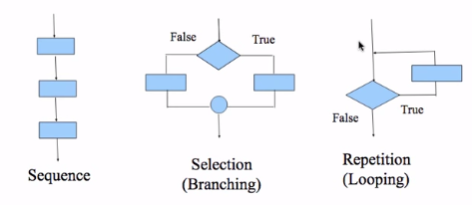
What is Algorithm

Slide 8
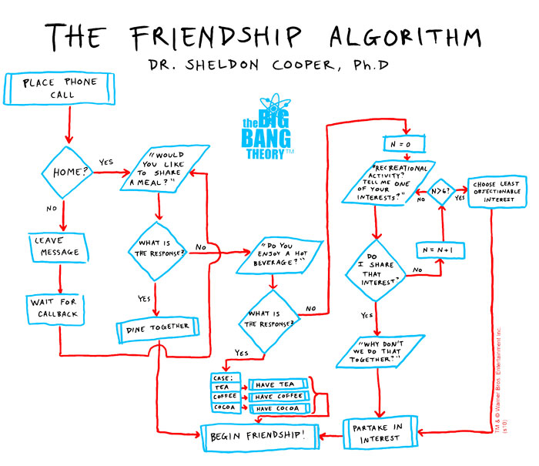
What is Algorithm

Slide 9
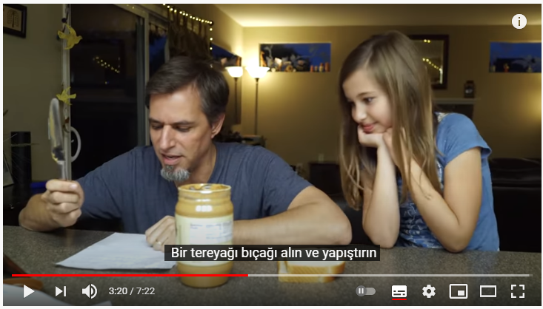
What is Algorithm

Slide 10
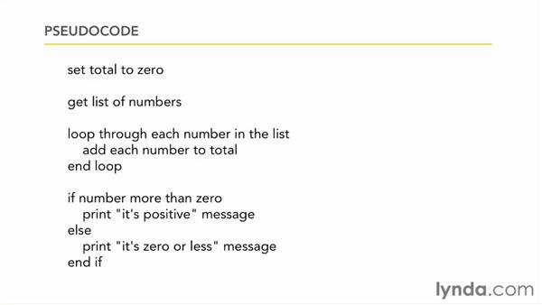
What is Algorithm
Notes:
Pseudocode is a notation resembling a simplified programming language, used in program design.
Pseudocode is an artificial and informal language that helps programmers develop algorithms. Pseudocode is a "text-based" detail (algorithmic) design tool. The rules of Pseudocode are reasonably straightforward. All statements showing "dependency" are to be indented.

Slide 11

What is algorithm?
What is pseudocode?
Notes:
Takeaway
Use this template to help students articulate and retain their biggest takeaways from the day.
🍐 This is a Pear Deck Text Slide
🍐 To edit the type of question, go back to the "Ask Students a Question" in the Pear Deck sidebar.

Slide 12
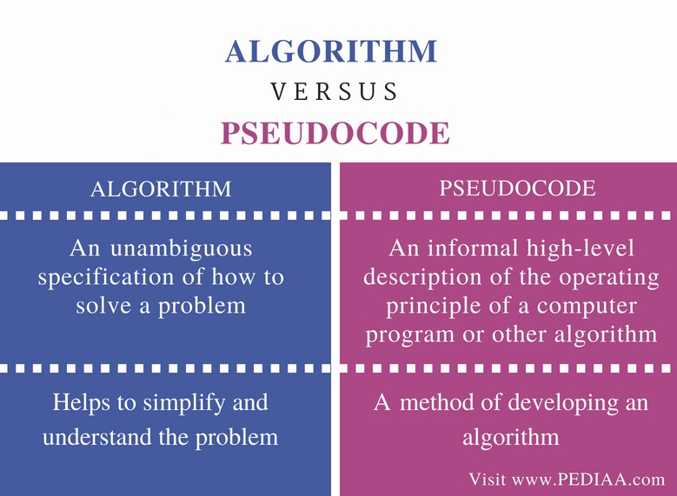
What is Algorithm

Slide 13
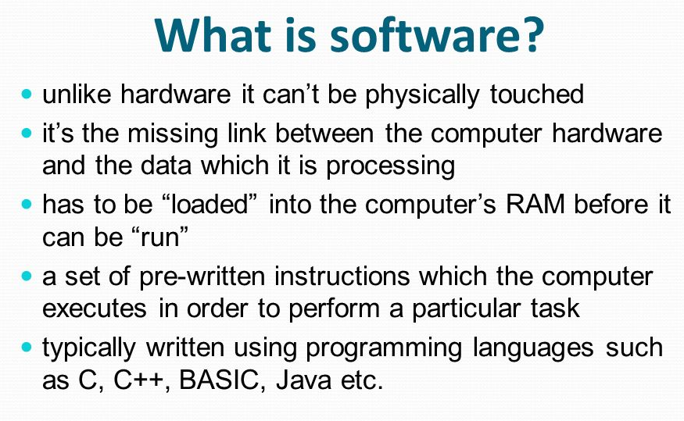
Software

Slide 14
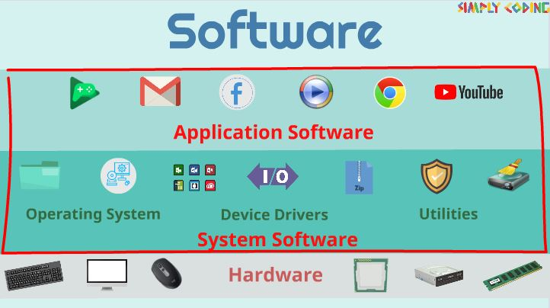
Software
Notes:
Hardware
System Software
Application Software

Slide 15


Have you heard of any of Programming Languages?
Yes
No
Notes:
True or False
Use this template to do a quick check of students’ perceptions during your lesson.
🍐 This is a Pear Deck Multiple Choice Slide. Your current options are: A: Yes, B: No,
🍐 To edit the type of question or choices, go back to the "Ask Students a Question" in the Pear Deck sidebar.

Slide 16
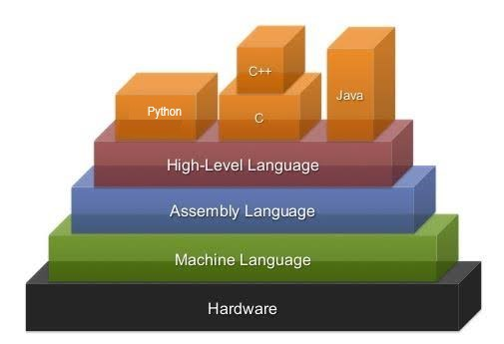
Software
Notes:
There is a middleware between 0 and 1’s(Machine language) and high level languages.It is Assembly language which is take orders from high level language and translate them to the machine language.

Slide 17
Software
Low Level Languages:
Assembly Language
Machine Language
Notes:
There is a middleware between 0 and 1’s(Machine language) and high level languages.It is Assembly language which is take orders from high level language and translate them to the machine language.

Slide 18
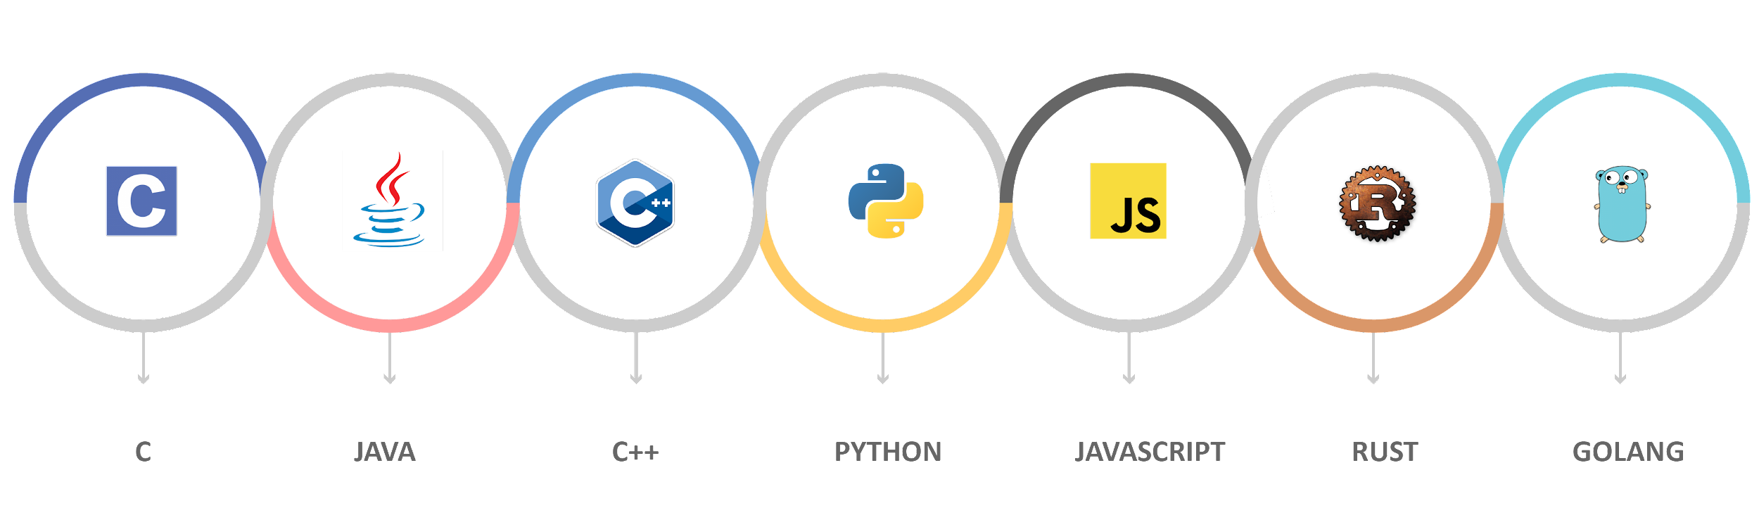
Software
High Level Languages:
Notes:
There is a middleware between 0 and 1’s(Machine language) and high level languages.It is Assembly language which is take orders from high level language and translate them to the machine language.

Slide 19
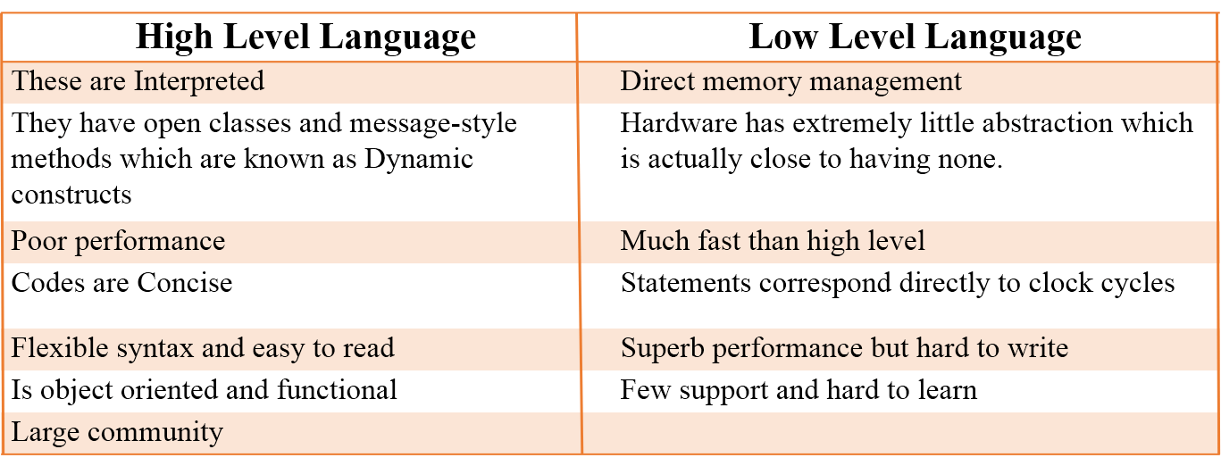
Software
Notes:
Direct memory access (DMA) is a feature of computer systems that allows certain hardware subsystems to access main system memory (random-access memory) independently of the CPU.
A clock cycle, or simply a "cycle," is a single electronic pulse of a CPU. ... Since modern processors can complete millions of clock cycles every second, processor speeds are often measured in megahertz or gigahertz. The frequency of a processor is also known as the processor's clock speed.

Slide 20
What does highlevel/ lowlevel mean?
Notes:
Takeaway
Use this template to help students articulate and retain their biggest takeaways from the day.
🍐 This is a Pear Deck Text Slide
🍐 To edit the type of question, go back to the "Ask Students a Question" in the Pear Deck sidebar.

Slide 21
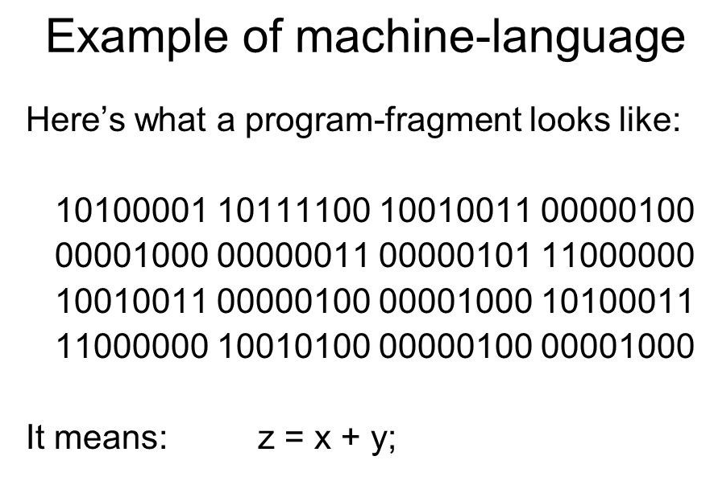
Machine Language

Slide 22
Assembly Language
Assembly is converted to machine code
mov %esp,%ebp
sub $0x28,%esp
mov 0x804d300,%eax
add $0x1,%eax
mov %eax,0x804d300
mov 0x804d300,%eax
cmp 0x8(%ebp),%eax
Notes:
Assembly Language uses mnemonic, to represent each of the machine language commands.
Sometimes abbreviated asm
Adding numbers 2 and 3 and getting the result in assembly code is as such
Assembly Language uses short descriptive words, know as mnemonic, to represent each of the machine language commands.
Assembly Language is not useful for computers. For that reason, it should be translated into machine language
Assembly code is converted into executable machine code by a utility program referred to as an assembler
mov - move
sub - subtract
add - addition
cmp - compare
jump - move to another line of code

Slide 23
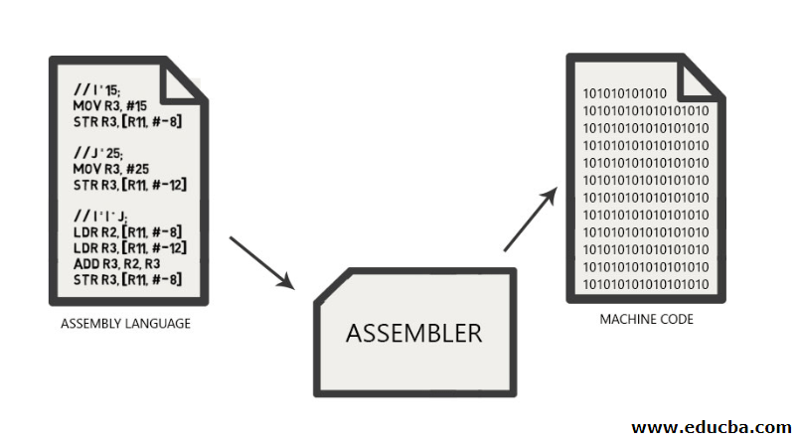
Assembly Language

Slide 24
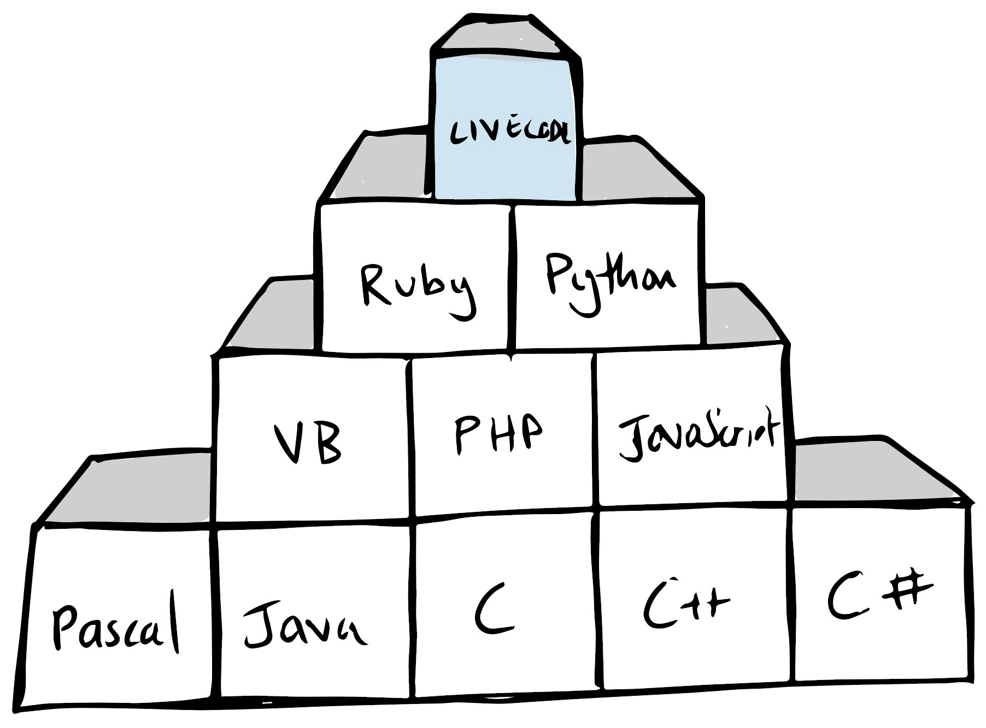
High Level Languages

Slide 25
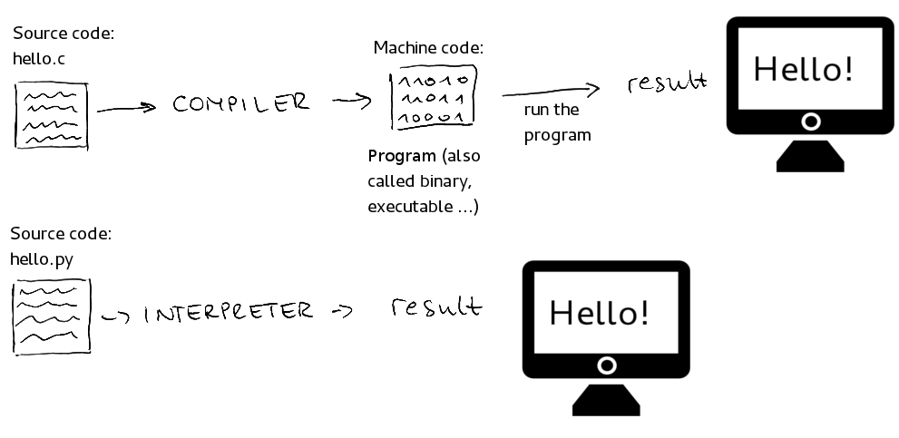
High Level Languages

Slide 26
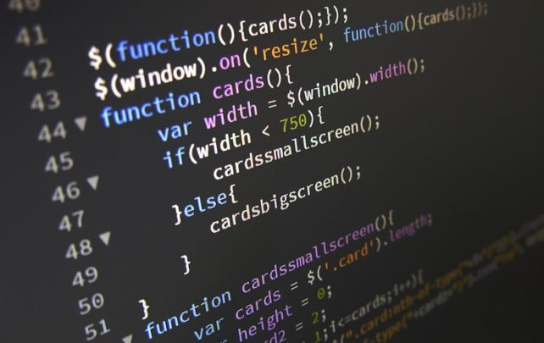
High Level Languages
Source Code:
Source code is a human-readable text written in a specific programming language.

Slide 27
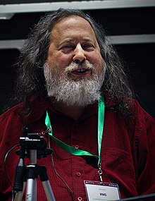





High Level Languages
Free Software vs. Open Source Software
Richard Stallman
Linus Torvalds

Slide 28
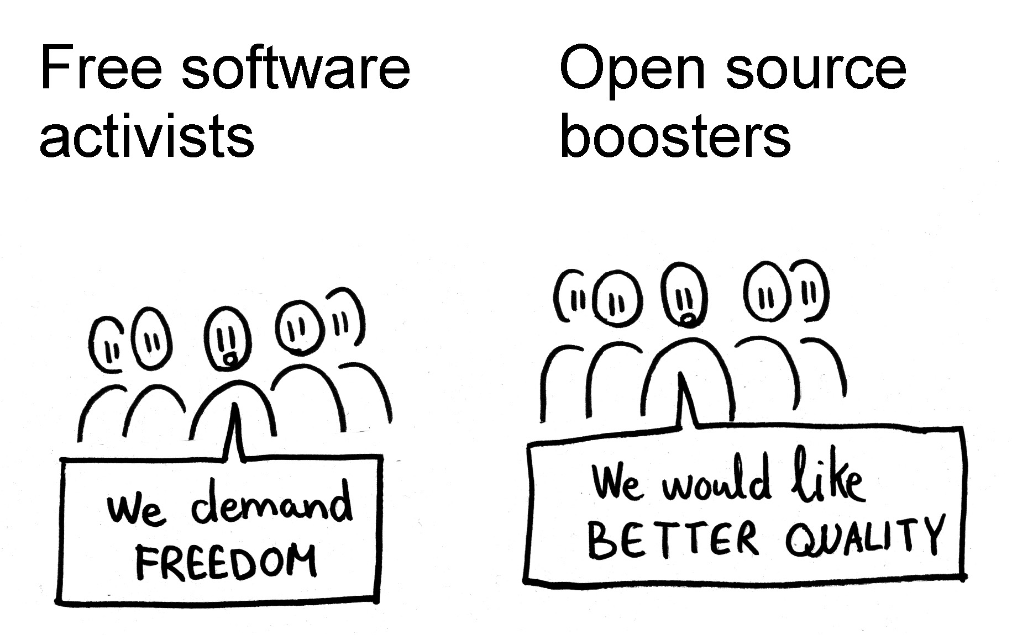
High Level Languages
ethical
approach
technical approach

Slide 29
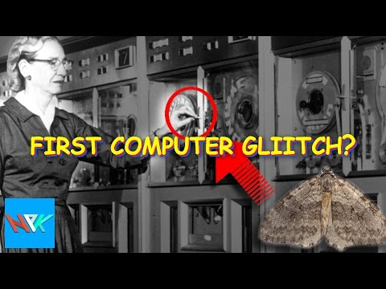
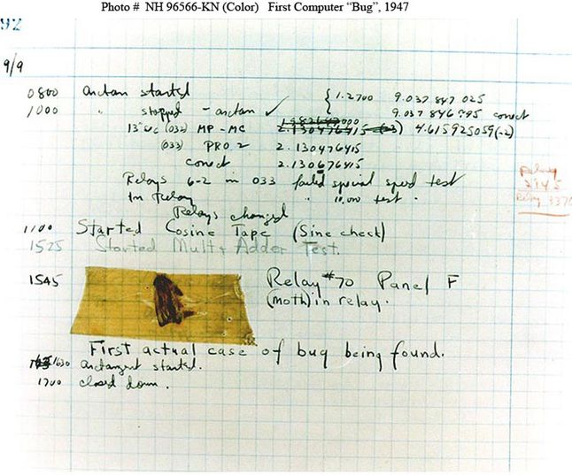
High Level Languages
Bug:
Story: named after a moth
Two types: syntax and logic errors
prnt(“I could forgotten something.”)

Slide 30
High Level Languages
print(”Clarusway Rocks”)
Notes:
Syntax
print - function name
() - enclosed in parenthesis
“ - encapsulated in quotes

Slide 31
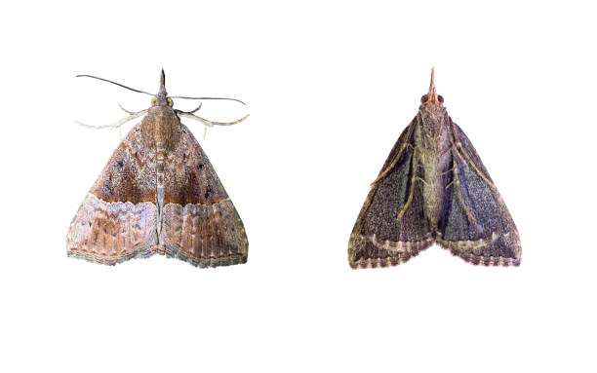
Find bugs and write the correct ones to right hand side:
Instructions
print(5, 7;
prnt(1, 2);
print("hello world);
Notes:
Label the Diagram
This is an example of a labeling activity. Swap the bee image out for your own illustration, diagram, or map. You can use the Word Bank to prompt students with the labels they need to use.
🍐 This is a Pear Deck Drawing Slide
🍐 To edit the type of question, go back to the "Ask Students a Question" in the Pear Deck sidebar.

Slide 32
Libraries/Packages/Frameworks
Library:
A software library generally consists of pre-written code, classes, procedures, scripts, configuration data and more. Typically, a developer might manually add a software library to a program to achieve more functionality or to automate a process without writing code for it.
Notes:
There was big computers and these computers sometimes was crashing because of moth. When computer doesn’t work engineers look after to bugs at the big computers. For this reason today we are calling bug to code mistakes/errors.
Example: prnt must be print

Slide 33
Libraries/Packages/Frameworks
FUNCTION
FUNCTION
MODULE
FUNCTION
FUNCTION
Notes:
There was big computers and these computers sometimes was crashing because of moth. When computer doesn’t work engineers look after to bugs at the big computers. For this reason today we are calling bug to code mistakes/errors.
Example: prnt must be print

Slide 34
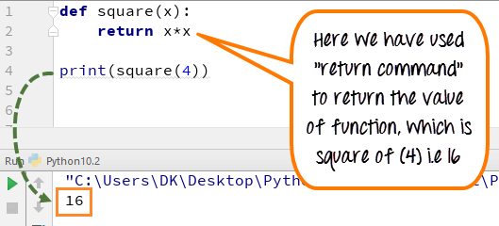
Libraries/Packages/Frameworks
Notes:
There was big computers and these computers sometimes was crashing because of moth. When computer doesn’t work engineers look after to bugs at the big computers. For this reason today we are calling bug to code mistakes/errors.
Example: prnt must be print

Slide 35
Libraries/Packages/Frameworks
MODULE
MODULE
PACKAGE
MODULE
MODULE
Notes:
There was big computers and these computers sometimes was crashing because of moth. When computer doesn’t work engineers look after to bugs at the big computers. For this reason today we are calling bug to code mistakes/errors.
Example: prnt must be print

Slide 36
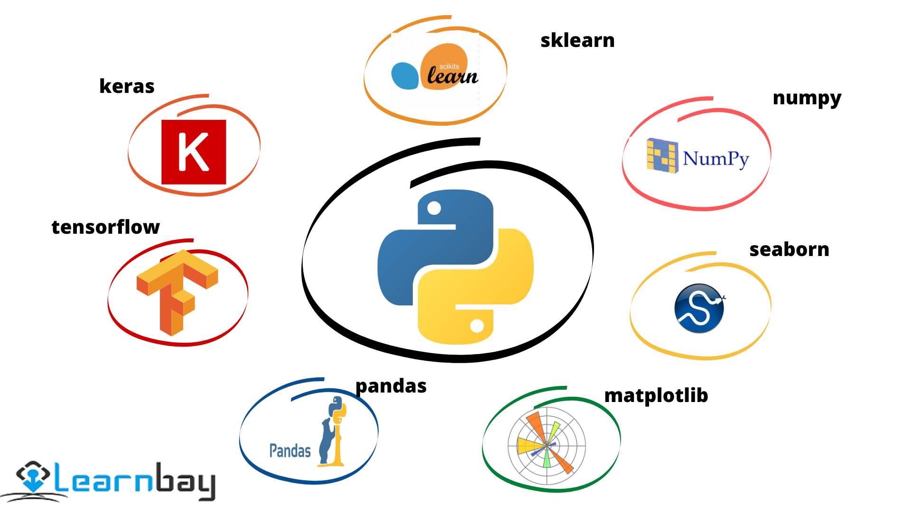
Libraries/Packages/Frameworks
PACKAGE
PACKAGE
LIBRARY
PACKAGE
PACKAGE
Notes:
There was big computers and these computers sometimes was crashing because of moth. When computer doesn’t work engineers look after to bugs at the big computers. For this reason today we are calling bug to code mistakes/errors.
Example: prnt must be print

Slide 37
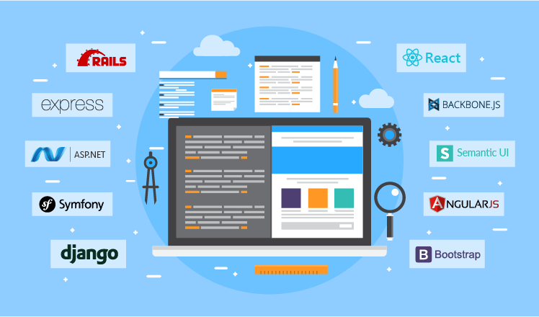
Libraries/Packages/Frameworks
Framework:
Frameworks are software that is developed and used by developers to build applications.
Notes:
IDE - An integrated development environment (IDE) is software for building applications that combines common developer tools into a single graphical user interface (GUI).
Visual Studio - A standalone source code editor that runs on Windows, macOS, and Linux. The top pick for JavaScript and web developers.
SQL Developer for Oracle Database

Slide 38
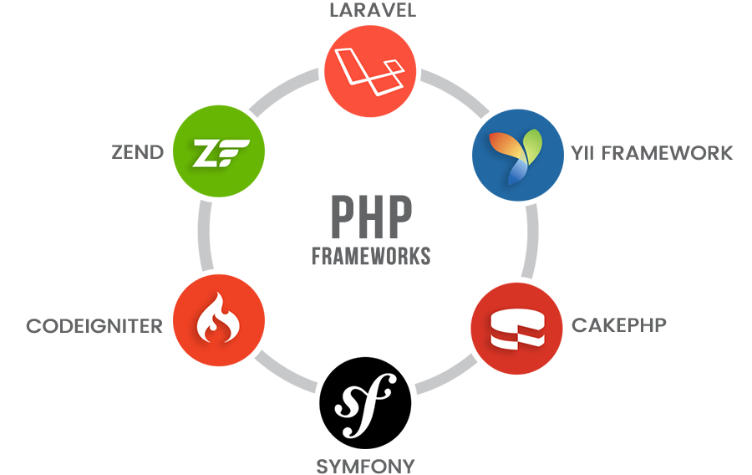
Libraries/Packages/Frameworks
Framework:
Web Application Framework
Mobile Development Frameworks
DataScience Frameworks
Notes:
There was big computers and these computers sometimes was crashing because of moth. When computer doesn’t work engineers look after to bugs at the big computers. For this reason today we are calling bug to code mistakes/errors.
Example: prnt must be print

Slide 39

Libraries/Packages/Frameworks
Web Framework
Notes:
There was big computers and these computers sometimes was crashing because of moth. When computer doesn’t work engineers look after to bugs at the big computers. For this reason today we are calling bug to code mistakes/errors.
Example: prnt must be print

Slide 40
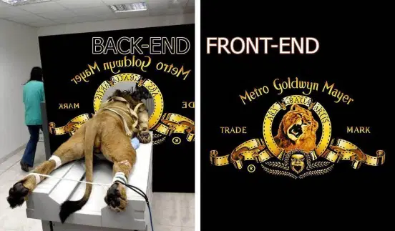
Backend/Frontend
Notes:
There was big computers and these computers sometimes was crashing because of moth. When computer doesn’t work engineers look after to bugs at the big computers. For this reason today we are calling bug to code mistakes/errors.
Example: prnt must be print

Slide 41
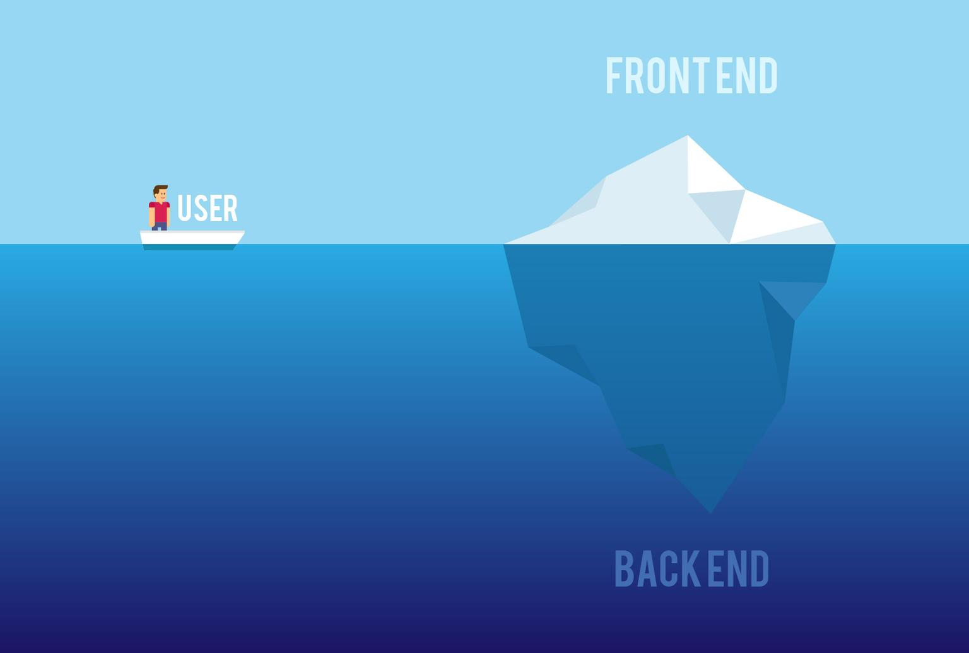
Backend/Frontend
Notes:
There was big computers and these computers sometimes was crashing because of moth. When computer doesn’t work engineers look after to bugs at the big computers. For this reason today we are calling bug to code mistakes/errors.
Example: prnt must be print

Slide 42
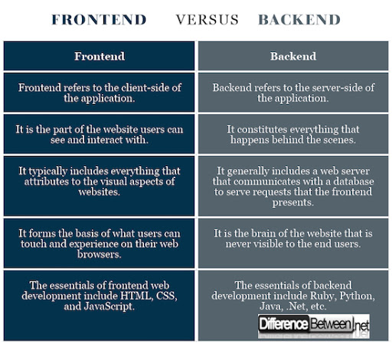
Backend/Frontend
Notes:
There was big computers and these computers sometimes was crashing because of moth. When computer doesn’t work engineers look after to bugs at the big computers. For this reason today we are calling bug to code mistakes/errors.
Example: prnt must be print

Slide 43
In one minute, write the most important thing from Software’s topic.
Notes:
Takeaway
Use this template to help students articulate and retain their biggest takeaways from the day.
🍐 This is a Pear Deck Text Slide
🍐 To edit the type of question, go back to the "Ask Students a Question" in the Pear Deck sidebar.

Slide 44
Computer Fundamentals
“Internet”

Slide 45
Agenda
Internet
TCP/IP Protocol
DNS
LAN/WAN

Slide 46
Notes:
Kahoot url: CF Review https://create.kahoot.it/details/a631b609-2c84-4d21-a9fe-cbe5f8ca47f1

Slide 47

Internet
Network of networks!

Slide 48
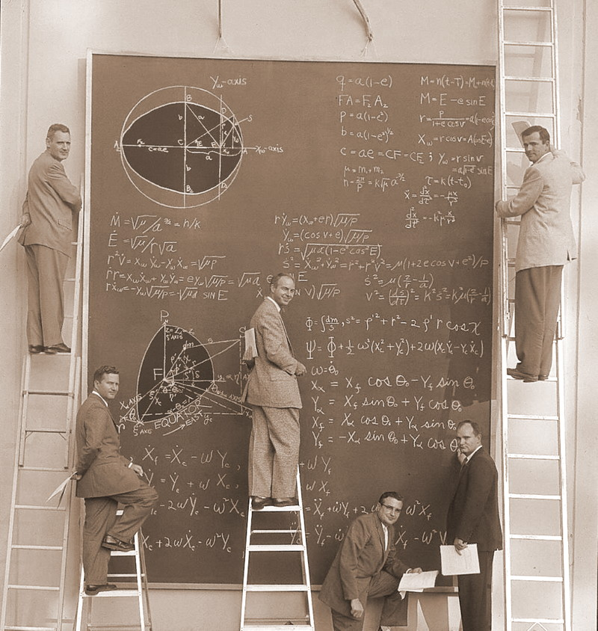

Internet
Common Sense

Slide 49
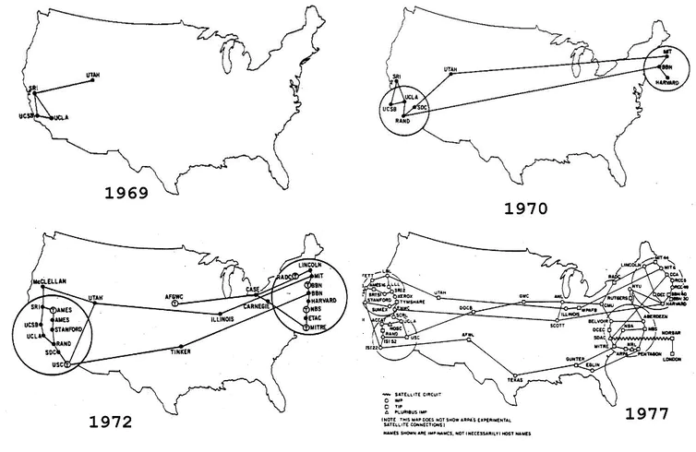
Internet
ARPANET
(The Advanced Research Projects Agency Network)
Notes:
ARPANET - experimental computer network that was the forerunner of the Internet.
The Advanced Research Projects Agency (ARPA), an arm of the U.S. Defense Department, funded the development of the Advanced Research Projects Agency Network (ARPANET) in the late 1960s.
Its initial purpose was to link computers at Pentagon-funded research institutions over telephone lines.
Academic

Slide 50
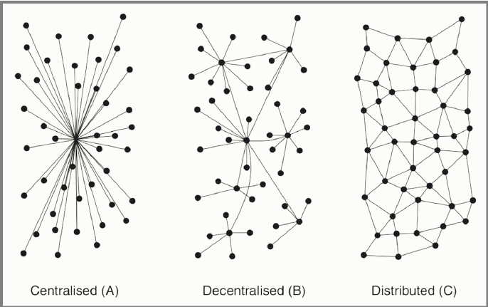
Internet

Slide 51
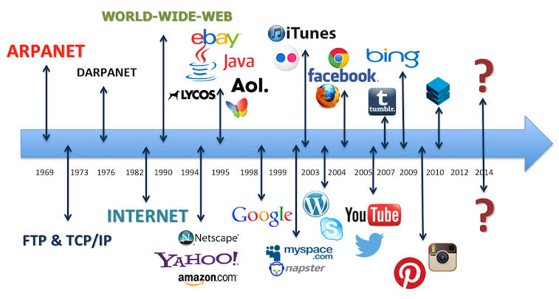

Internet

Slide 52
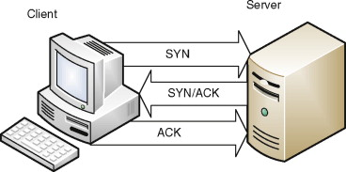
TCP/IP Protocol
IP: Internet Protocol
TCP: Transmission Control Protocol
Rules for sending information between computers
Followed by both clients and servers

Slide 53
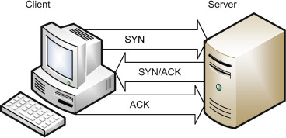
TCP/IP Protocol
Before connection, server and client should shake their hands three times!
Three hand shake:
Notes:
HTTP (Hypertext Transfer Protocol) is a request-response protocol
Client Side (Web Browser) - Server Side (Web Hosting)
A client on one side asks or requests something from a server and the server on the other side sends a response to that client.
But before this request and response activities, a connection should be established (Three Handshake)
Three-Way HandShake or a TCP 3-way handshake is a process which is used in a TCP/IP network to make a connection between the server and client. It is a three-step process that requires both the client and server to exchange synchronization and acknowledgment packets before the real data communication process starts.

Slide 54
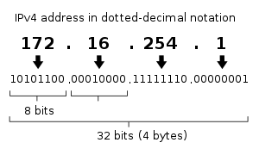
TCP/IP Protocol
IP Number:
4,294,967,296
Notes:
HTTP (Hypertext Transfer Protocol) is a request-response protocol
Client Side (Web Browser) - Server Side (Web Hosting)
A client on one side asks or requests something from a server and the server on the other side sends a response to that client.
But before this request and response activities, a connection should be established (Three Handshake)

Slide 55
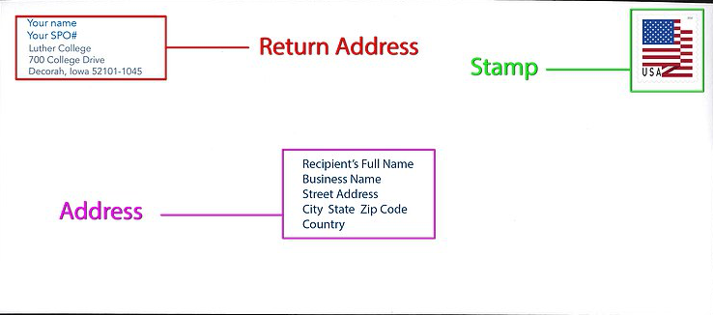
TCP/IP Protocol
Notes:
HTTP (Hypertext Transfer Protocol) is a request-response protocol
Client Side (Web Browser) - Server Side (Web Hosting)
A client on one side asks or requests something from a server and the server on the other side sends a response to that client.
But before this request and response activities, a connection should be established (Three Handshake)

Slide 56
TCP/IP Protocol
34.36.25.28
155.123.11.44
IP Address
Notes:
HTTP (Hypertext Transfer Protocol) is a request-response protocol
Client Side (Web Browser) - Server Side (Web Hosting)
A client on one side asks or requests something from a server and the server on the other side sends a response to that client.
But before this request and response activities, a connection should be established (Three Handshake)

Slide 57
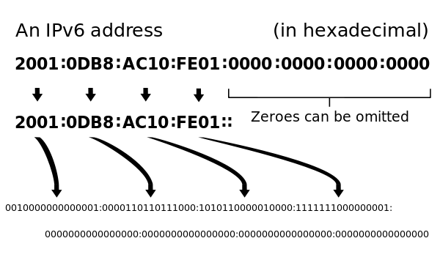
TCP/IP Protocol
128 bit
Notes:
HTTP (Hypertext Transfer Protocol) is a request-response protocol
Client Side (Web Browser) - Server Side (Web Hosting)
A client on one side asks or requests something from a server and the server on the other side sends a response to that client.
But before this request and response activities, a connection should be established (Three Handshake)

Slide 58
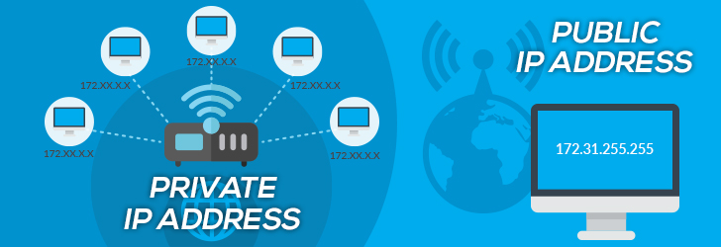
TCP/IP Protocol
Notes:
HTTP (Hypertext Transfer Protocol) is a request-response protocol
Client Side (Web Browser) - Server Side (Web Hosting)
A client on one side asks or requests something from a server and the server on the other side sends a response to that client.
But before this request and response activities, a connection should be established (Three Handshake)
A public IP address identifies you to the wider internet so that all the information you're searching for can find you. A private IP address is used within a private network to connect securely to other devices within that same network. Each device within the same network has a unique private IP address.

Slide 59
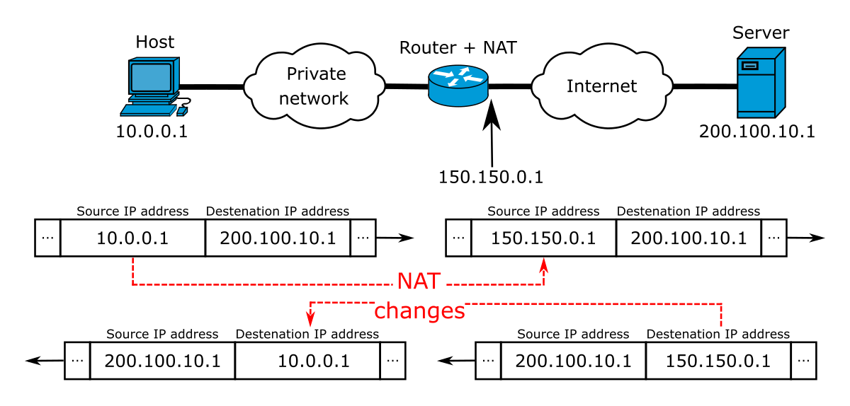
TCP/IP Protocol
NAT : Network Address Translation
Notes:
HTTP (Hypertext Transfer Protocol) is a request-response protocol
Client Side (Web Browser) - Server Side (Web Hosting)
A client on one side asks or requests something from a server and the server on the other side sends a response to that client.
But before this request and response activities, a connection should be established (Three Handshake)
It's a way to map multiple local private addresses to a public one before transferring the information. Organizations that want multiple devices to employ a single IP address use NAT, as do most home routers.

Slide 60
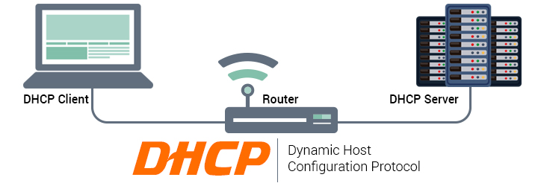
TCP/IP Protocol
Notes:
HTTP (Hypertext Transfer Protocol) is a request-response protocol
Client Side (Web Browser) - Server Side (Web Hosting)
A client on one side asks or requests something from a server and the server on the other side sends a response to that client.
But before this request and response activities, a connection should be established (Three Handshake)
Dynamic Host Configuration Protocol (DHCP) is a client/server protocol that automatically provides an Internet Protocol (IP) host with its IP address and other related configuration information such as the subnet mask and default gateway. DHCP allows hosts to obtain required TCP/IP configuration information from a DHCP server.

Slide 61


TCP/IP Protocol
Packages
Notes:
HTTP (Hypertext Transfer Protocol) is a request-response protocol
Client Side (Web Browser) - Server Side (Web Hosting)
A client on one side asks or requests something from a server and the server on the other side sends a response to that client.
But before this request and response activities, a connection should be established (Three Handshake)
In its simplest form, a packet is the basic unit of information in network transmission. ... Packets are transmitted over Ethernet networks, the most common physical type, within frames, or pre-set data blocks that have their own header and trailer information.

Slide 62
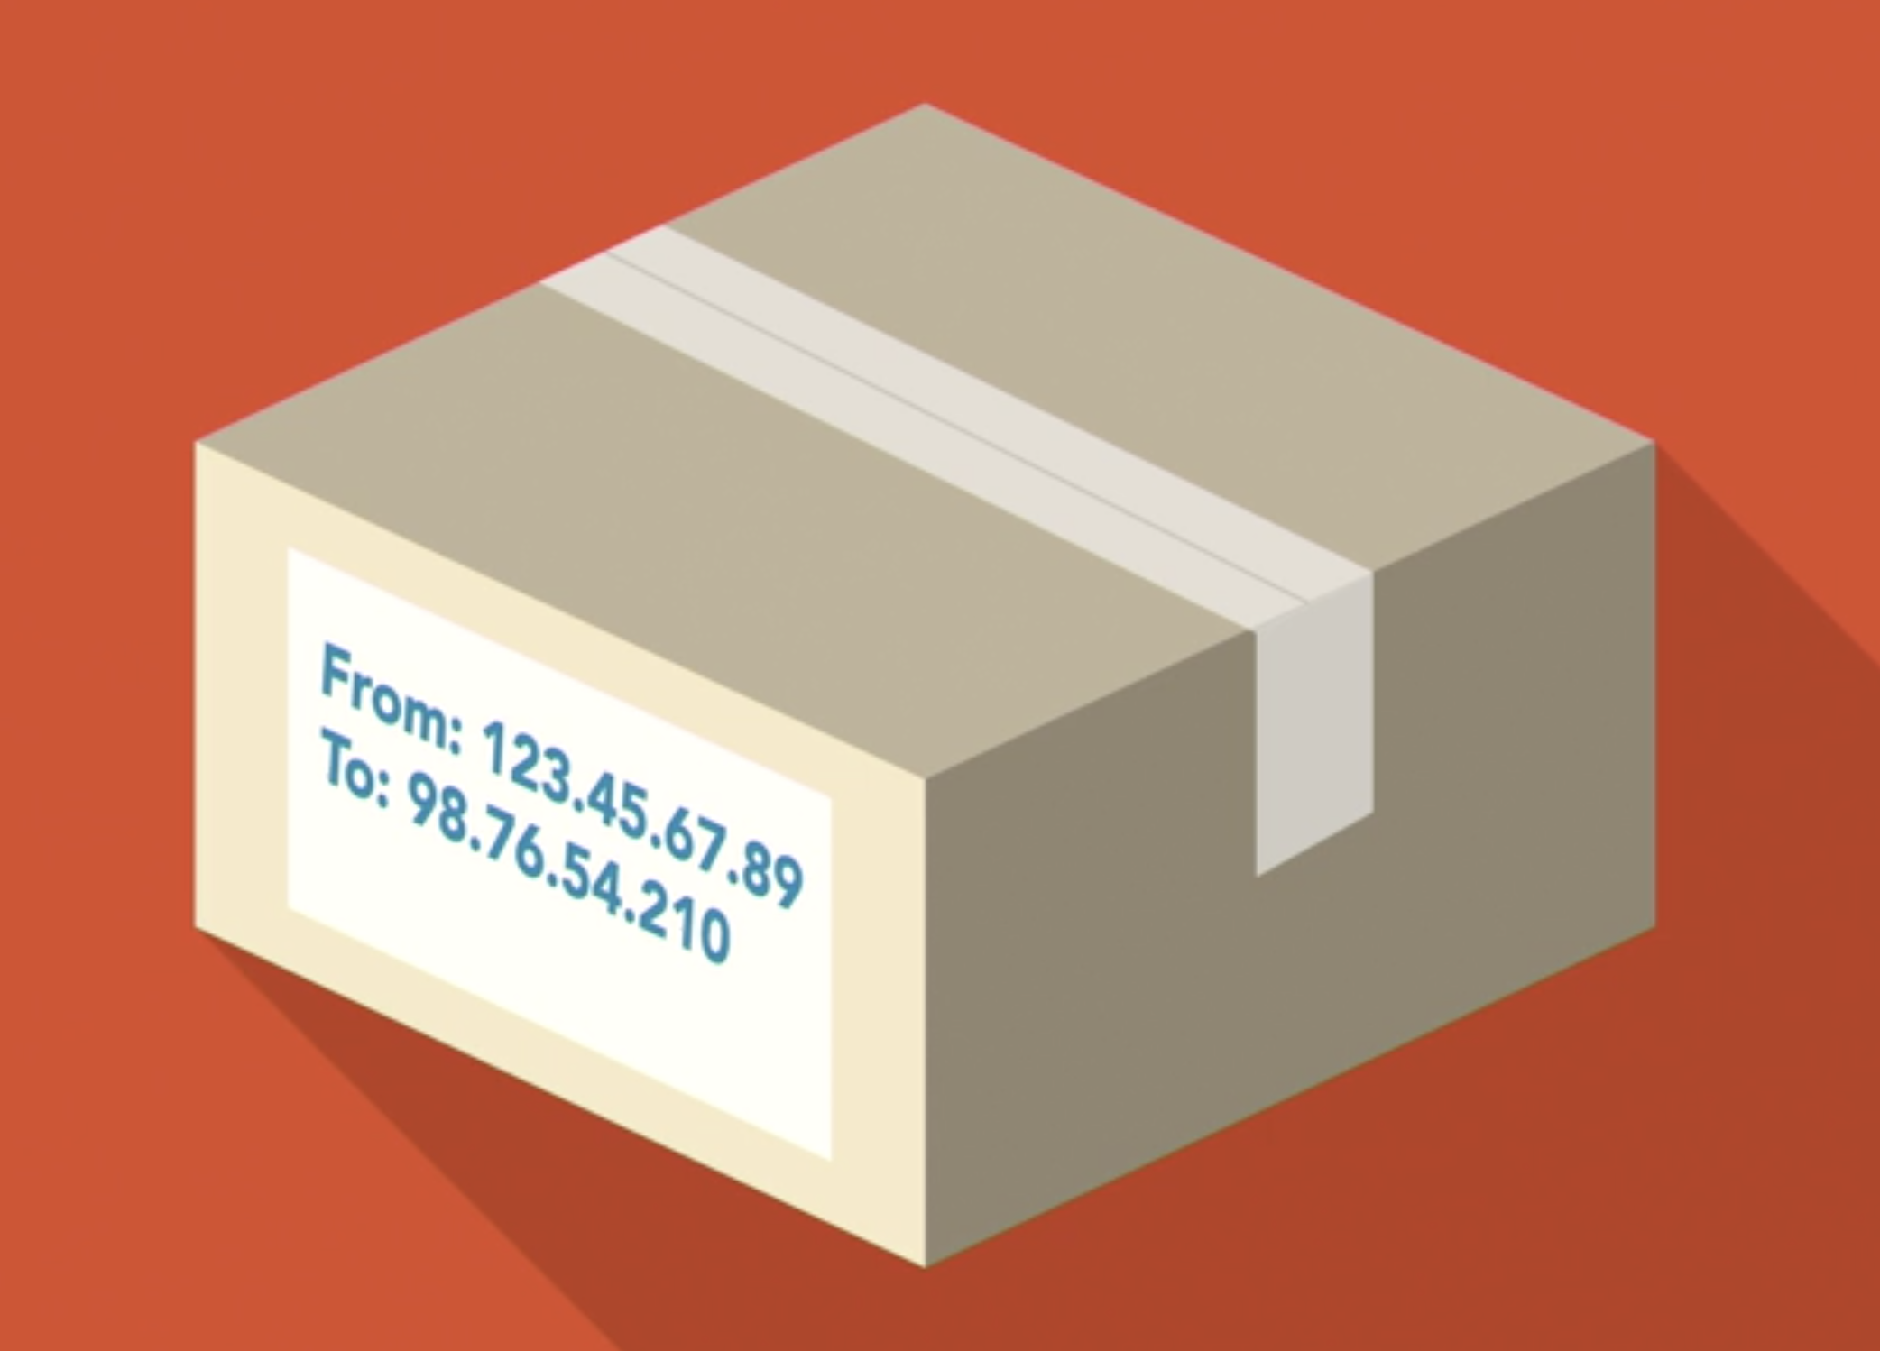
TCP/IP Protocol
COMPUTER-1
(132.45.67.89)
COMPUTER-2
(98.76.54.210)
FROM 132.45.67.89 TO 98.76.54.210 2KB PACKET#1
FROM 132.45.67.89 TO 98.76.54.210 2KB PACKET#2
FROM 132.45.67.89 TO 98.76.54.210 2KB PACKET#3
FROM 132.45.67.89 TO 98.76.54.210 2KB PACKET#4
Notes:
HTTP (Hypertext Transfer Protocol) is a request-response protocol
Client Side (Web Browser) - Server Side (Web Hosting)
A client on one side asks or requests something from a server and the server on the other side sends a response to that client.
But before this request and response activities, a connection should be established (Three Handshake)

Slide 63
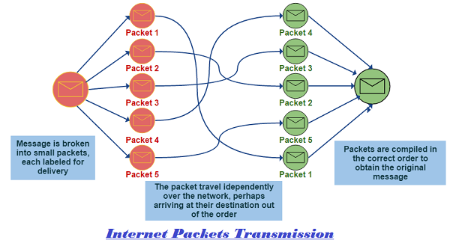
TCP/IP Protocol
Notes:
HTTP (Hypertext Transfer Protocol) is a request-response protocol
Client Side (Web Browser) - Server Side (Web Hosting)
A client on one side asks or requests something from a server and the server on the other side sends a response to that client.
But before this request and response activities, a connection should be established (Three Handshake)

Slide 64
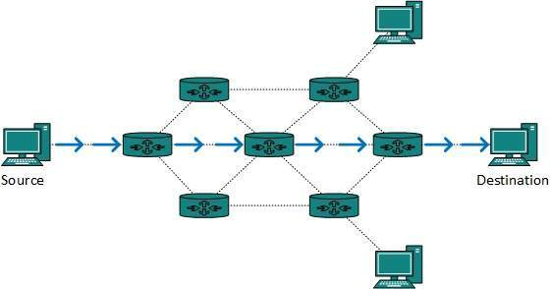
TCP/IP Protocol
Router
Notes:
Routers connect two or more networks and provide the routing function. Some routers, for example, route at the network interface level or at the physical level.

Slide 65
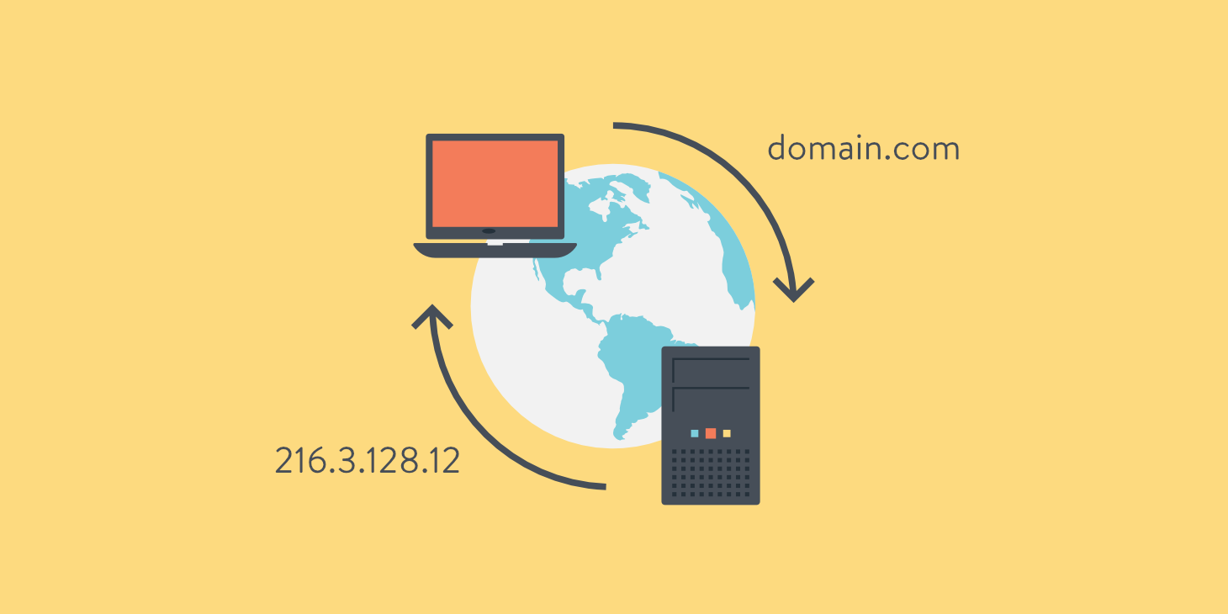
DNS
Domain Name Server
Notes:
The Domain Name System (DNS) is the phonebook of the Internet. Humans access information online through domain names, like google.com or clarusway.com.

Slide 66
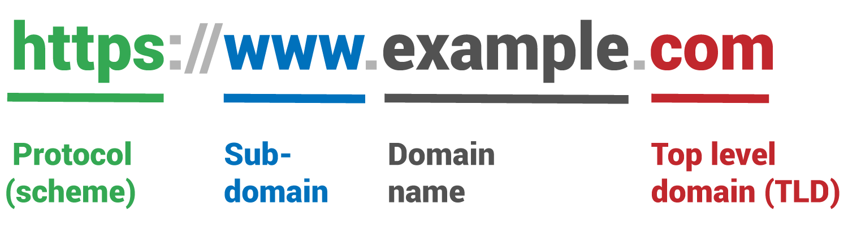
DNS
URL: Uniform Resource Locator

Slide 67
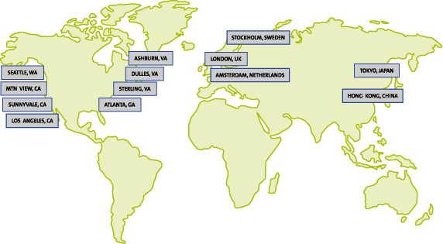
DNS
Root DNS
Notes:
The authoritative name servers that serve the DNS root zone, commonly known as the “root servers”, are a network of hundreds of servers in many countries around the world. They are configured in the DNS root zone as 13 named authorities

Slide 68
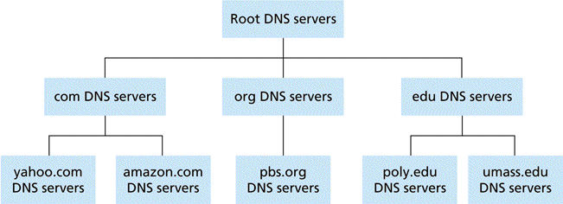
DNS

Slide 69
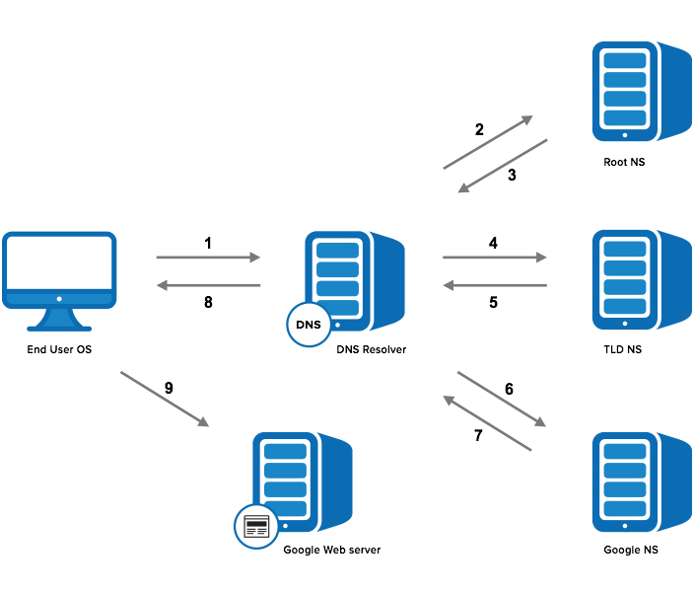
DNS
Notes:
A DNS resolver, also known as a resolver, is a server on the Internet that converts domain names into IP addresses.

Slide 70
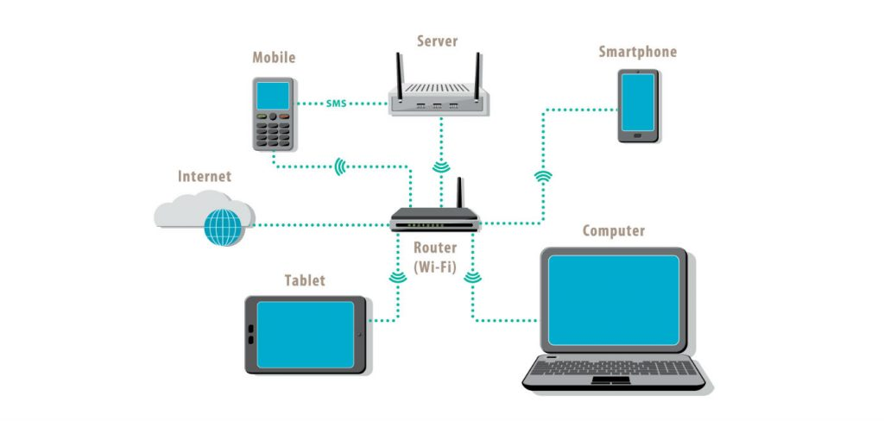
LAN/WAN
LAN: Local Area Network

Slide 71

LAN/WAN
WAN: Wide Area Network

Slide 72

Let’s Practice
Notes:
Click image to go online traceroute service for https://traceroute-online.com/ web site

Slide 73

LAN/WAN

Slide 74

Please write what is
- Internet
IP address
TCP/IP
DNS
Notes:
Summarize
Have students write a quick, 1-2 sentence summary of the information they’ve just learned.
🍐 This is a Pear Deck Text Slide
🍐 To edit the type of question, go back to the "Ask Students a Question" in the Pear Deck sidebar.

Slide 75


Circle how you are feeling:
Notes:
Emotion Check
Use this template to prompt students to check in with themselves. This will also help you gauge the mood in your classroom and notice any students who might attention.
🍐 This is a Pear Deck Drawing Slide
🍐 To edit the type of question, go back to the "Ask Students a Question" in the Pear Deck sidebar.

Slide 76

THANKS!
Any questions?
You can find me at:
@Jamil
jamil@clarusway.com
@Tomy
tomy@clarusway.com

